Slide 1
Digital image processing and analysis Introduction
Professor Ela Claridge
School of Computer Science

Slide 2
A widening horizons module

Slide 3
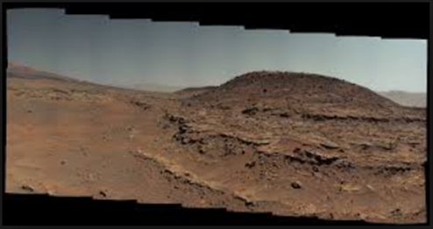
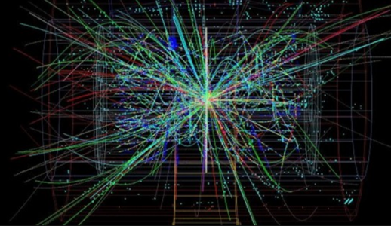
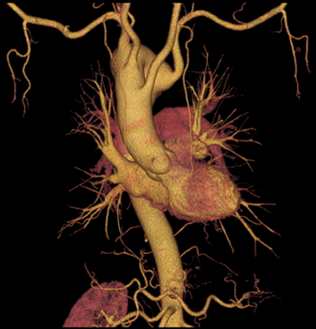
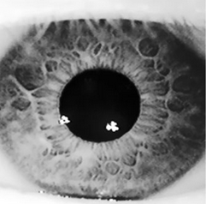
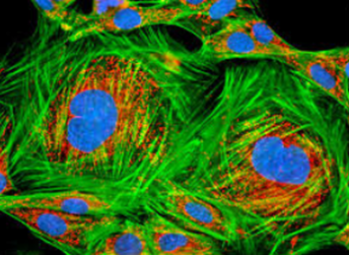
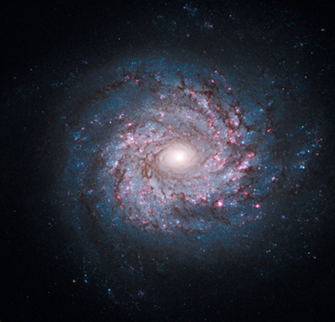

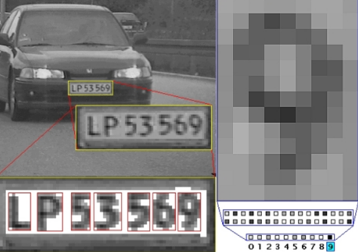
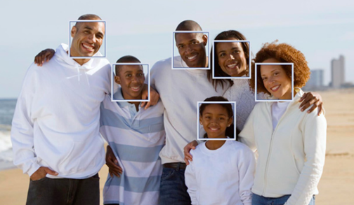
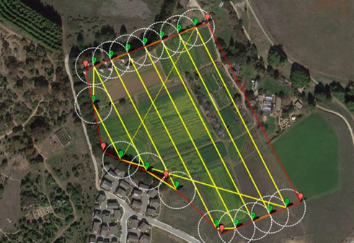
Heart and blood vessel segmentation
Mars landscape reconstruction
Subatomic particle tracking
Biometrics
Microscopy analysis
Galaxy classification
Car plate recognition
Face detection and recognition
Crop health

Slide 4
Heart and blood vessel segmentation
Mars landscape reconstruction
Subatomic particle tracking
Biometrics
Microscopy analysis
Galaxy classification
Car plate recognition
Face detection and recognition
Crop health

Slide 5
In this lecture we shall find out about:
Topics covered in the module
Learning outcomes
Material delivery and learning methods
Assessment

Slide 6
What this module is about
The fundamentals and practical applications of digital image processing
Digital images, acquisition and computer representation
Improving image quality
Object detection and description
Image alignment and stitching
Applications
Overview of selected advanced topics

Slide 7
What this module is about
By the end of this module you should be able to
Describe the basic concepts of image processing and image analysis.
Discuss the advantages and drawbacks of different methods.
Make informed choices about what methods to apply to solve specific image processing problems.
Use image processing tools to carry out simple practical image processing tasks.

Slide 8
What this module is about
What | How
Describe the basic concepts of image processing and image analysis. | Lectures, recommended reading
Discuss the advantages and drawbacks of different methods. | Lectures, recommended reading, unassessed exercises
Make informed choices about what methods to apply to solve specific image processing problems. | Lectures, demonstrations, unassessed exercises
Use image processing tools to carry out simple practical image processing tasks. | Demonstrations and unassessed exercises

Slide 9

What this module is about Delivery
Lectures (no panopto recordings, sorry)
Weeks 1-5 & 7-11
Wednesday 10-11
Thursday 9-10
Lab classes (demonstrations and practicals)
Weeks 2-5 & 7-9
Friday 9-10
Exercises (theory and problem solving)
Weeks 2-5 & 7-9
Unassessed, in own time
Outline solutions provided one week after the submission date
Fiji (ImageJ)

Slide 10
What this module is about Assessment
MCQ (Multiple Choice Question) tests
15% each
Via Canvas, open book, time limited (1 hr)
Sat in the lab
6 February by 11:00 am
6 March by 11:00 am
20 March by 11:00 am
Exam
55%
Unseen
Normal examination period
Reassessment
By examination only (i.e. quiz marks do not count)

Slide 11
What this module is about Assessment
Criteria
Materials from the lectures: up to 45%
Plus recommended further reading: up to 65%
Plus knowledge gained from exercises: up to 75%
Plus creativity: over 75%
Recommended effort / study time
200 hrs in total
20 lectures
8 lab classes
172 work-based learning and independent study (including exam preparation)

Slide 12
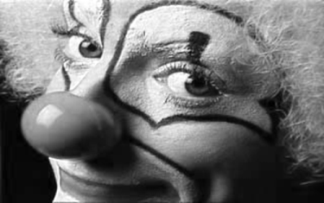

Lectures
Visual perception and digital image acquisition
Basics of visual perception
Digital image acquisition
Cameras and other imaging devices
Digital image properties
Digital image properties
Computer representation – pixels
Sampling – related to image coordinates
Quantisation – related to image values
… and how they relate to image acquisition

Slide 13
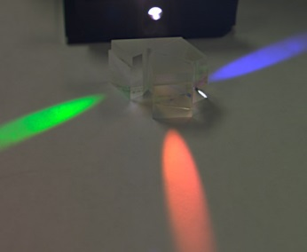
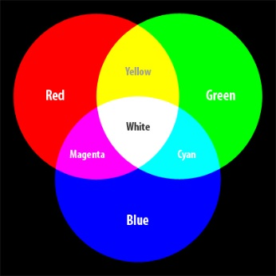
Lectures
Colours and their origins
Physical underpinnings
Human visual perception
Colour images
Image acquisition
Colour spaces
Digital representation of colour images
Colour mixing (vector arithmetics)
Pixel arrays
Colour models

Slide 14
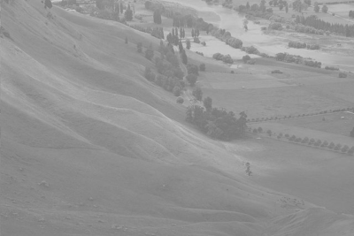
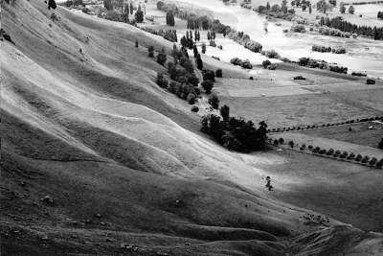
Lectures
Image enhancement and restoration
Image statistics
Image histogram
Manipulating image brightness
Contrast enhancement
Colour Lookup Table operations

Slide 15
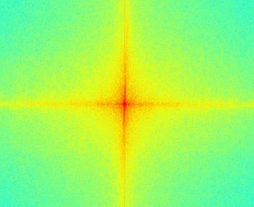
Lectures
Image enhancement: digital filtering
Convolution and convolution kernel
Smoothing filters
Gradient detection filters
Sharpening filters
Image enhancement: non-linear filters
N-th Order filtering
Median filter

Slide 16
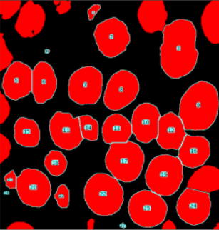
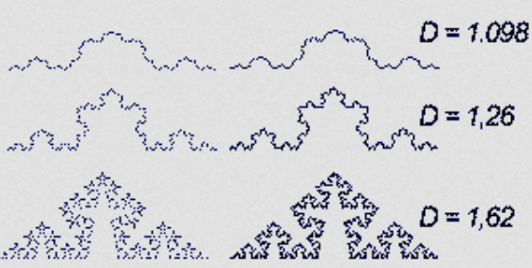
Lectures
Object characterisation
Detection (segmentation)
Counting
Localisation
Object characterisation
Shape
Texture

Slide 17
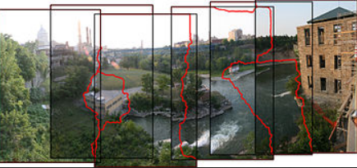
Lectures
Image registration (alignment)
Features to match
Classes of transforms
Similarity criteria
Image stitching
Features to match
Registration
Image interpolation

Slide 18
Lectures
Applications
Medicine
Biology
Remote sensing
Astronomy
Food
Forensics
…
Selected advanced topics

Slide 19
Further reading and exploration
On-line materials
Recommended (provided on lecture slides)
Own searches
Books
Sonka, M. Hlavac, V. Boyle, R. Image Processing, Analysis and Machine Vision, Chapman & Hall Computing (various editions).
Gonzalez, R.C. & Woods, R.E. Digital Image Processing, Addison-Wesley (various editions).
Umbaugh, S.E. Computer vision and image processing : a practical approach using CVIPtools , Prentice Hall International (various editions).

Slide 20
Next lecture:
FIJI (ImageJ) image processing and analysis software
Essentials
Basic concepts
Overview of functions and tools
Macros and programming
You can download your own copy:
https://imagej.net/Fiji/Downloads

Slide 21
Next lecture
Image formation
Digital image acquisition
Visual perception
Cameras and other imaging devices
… and how these two compare

Slide 22
Contact
Ela Claridge
School of Computer Science, room 139
Email: e.claridge@cs.bham.ac.uk

Slide 23
Any questions?

